Slide 1
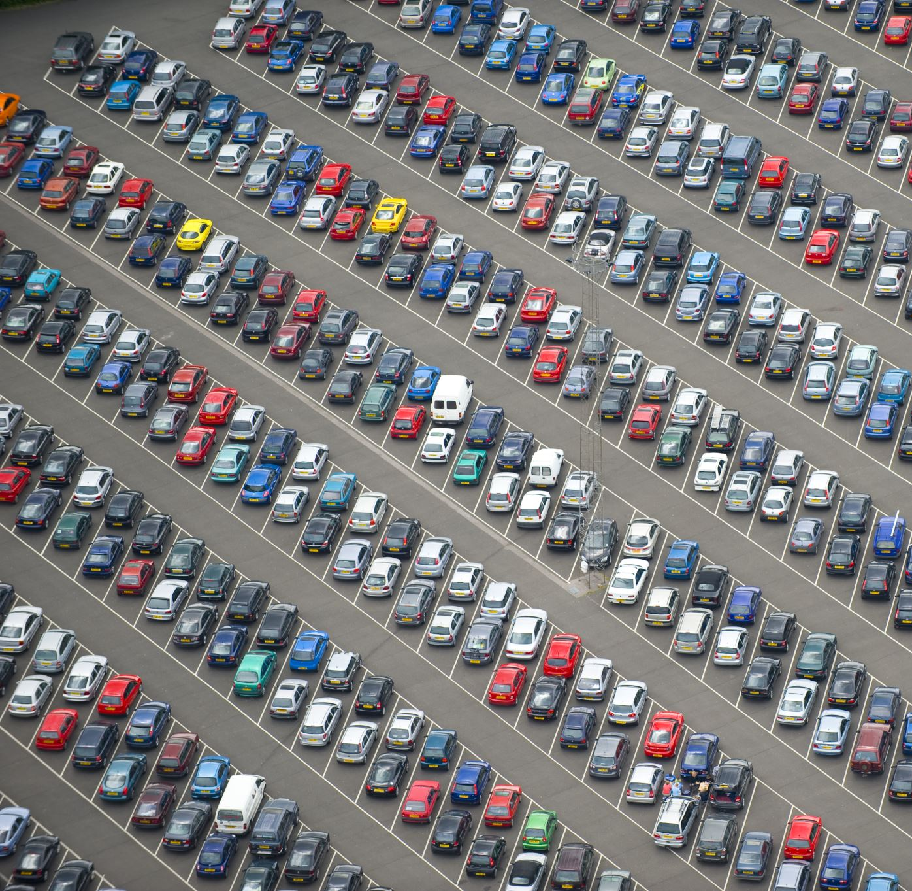
LARIAT CAR RENTAL
By Alton Baugh
Data Analyst

Slide 2
LARIAT 2018 PERFORMACNE
Cost $30,320,298
Gross revenue $52,829,787
Profit $22,509,489
Notes:
Here is a chart illustrating the overall company's performance over 2018
The red bar indicates the cost, the blue bar indicates gross and the amount of separation or lack of separation between those two bars illustrates the profit margin.
Splitting the cars into tiers based on our monthly cost including insurance and operating cost separates the high-end cars versus the budget cars and everything in between.
The values are in percentages to relate the percent of cost spent to percent gross revenue gained.
Our cars under the 575 and around 675 are our most profitable while our cars 775 and become less profitable.
Macro point and micro point
What is driving up the cost and what can be done to increase profit ?
Start off with companies goal for following year of cutting cost while maximizing revenue and cut cost.

Slide 3
COST ANALYSIS:THE STEEP CLIMB UP
Analysis Of Loss-making Vehicles
Daily Rental Charge Cost ($) | Average Monthly Cost | Sum Profit January to November | Count of Cars in Range | Sum Days Rented
215-230 | $764.17 | -$358 | 1 | 50
185-200 | $797.66 | -$1,691 | 4 | 226
170-185 | $798.58 | -$21,684 | 18 | 958
155-170 | $763.62 | -$26,821 | 31 | 1,767
140-155 | $766.65 | -$28,480 | 34 | 2,150
125-140 | $783.74 | -$17,280 | 11 | 612
Grand Total |  | -$96,314 | 99 | 5,763
Notes:
When the Avg daily rent prices were analyzed there seems to be a disconnect.
The initial thought was car with higher monthly cost would correlate to higher average daily rent prices however X% of cars in the above 775 were being rented out
AERAGE TOTAL MONTLHY COST $774.63
egdoug@gmail.com

Slide 4
PROFITABILITY ANALYSIS: CHOOSE YOUR FRIENDS WISELY
MOST PROFITABLE VEHICLES
LEAST PROFITABLE VEHICLES
VEHICLE MODEL | Sum Profit January to November | Average Days Rented | Average Monthly Total Cost
Pontiac Grand Prix | $138,748 | 82 | $667
Ford Ranger | $130,994 | 84 | $692
Mercury Grand Marquis | $129,392 | 83 | $704
Lincoln Town Car | $122,154 | 79 | $651
Mercury Sable | $121,540 | 82 | $655
Grand Total | $642,828 | 82 | $675
VEHICLE MODEL | Sum Profit January to November | Average Days Rented | Average Monthly Total Cost
Daewoo Nubira | -$3,271 | 53 | $836
Audi 5000CS | -$1,972 | 46 | $834
A5 | -$1,565 | 50 | $856
Saturn Relay | -$490 | 46 | $806
Plymouth Volare | -$393 | 35 | $727
Grand Total | -$7,692 | 46 | $812
Notes:
Removal of least profitable cars and add
Decrease most expensive cars
Increase most profitable cars.

Slide 5
PROPOSED STRATERGY 1: WHAT DOES FUTURE HOLD?
Notes:
Cutting cost was our first objective so taking a
20%
20%.
20%
1%
1%
Vehicles on lot 4,963
Gross Revenue $61,003,760
Cost $23,498,721
Profit $37,505,039

Slide 6
PROPOSED STRATERGY 2: WHAT DOES FUTURE HOLD?
Average Daily Rate ($) Tiers | Days rented | 2018 Baseline | Count of cars | 2019 Proj. @ 5% Growth | Count of cars
125-140 | 74 | $186,153 | 72 | $195,461 | 76
140-155 | 81 | $2,921,556 | 677 | $3,067,634 | 711
155-170 | 83 | $9,758,346 | 1732 | $10,246,263 | 1819
170-185 | 81 | $7,544,391 | 1194 | $7,921,611 | 1254
185-200 | 79 | $1,883,083 | 287 | $1,977,237 | 301
200-215 | 74 | $199,518 | 33 | $209,494 | 35
215-230 | 64 | $16,862 | 5 | $17,705 | 5
Grand Total | 535 | $22,509,909.00 | 4000 | $23,635,405 | 4200

Slide 7


QUESTIONS ?

